Slide 1
Financial
Counseling
CFS
5
Second Edition
Updated July 2025

Slide 2

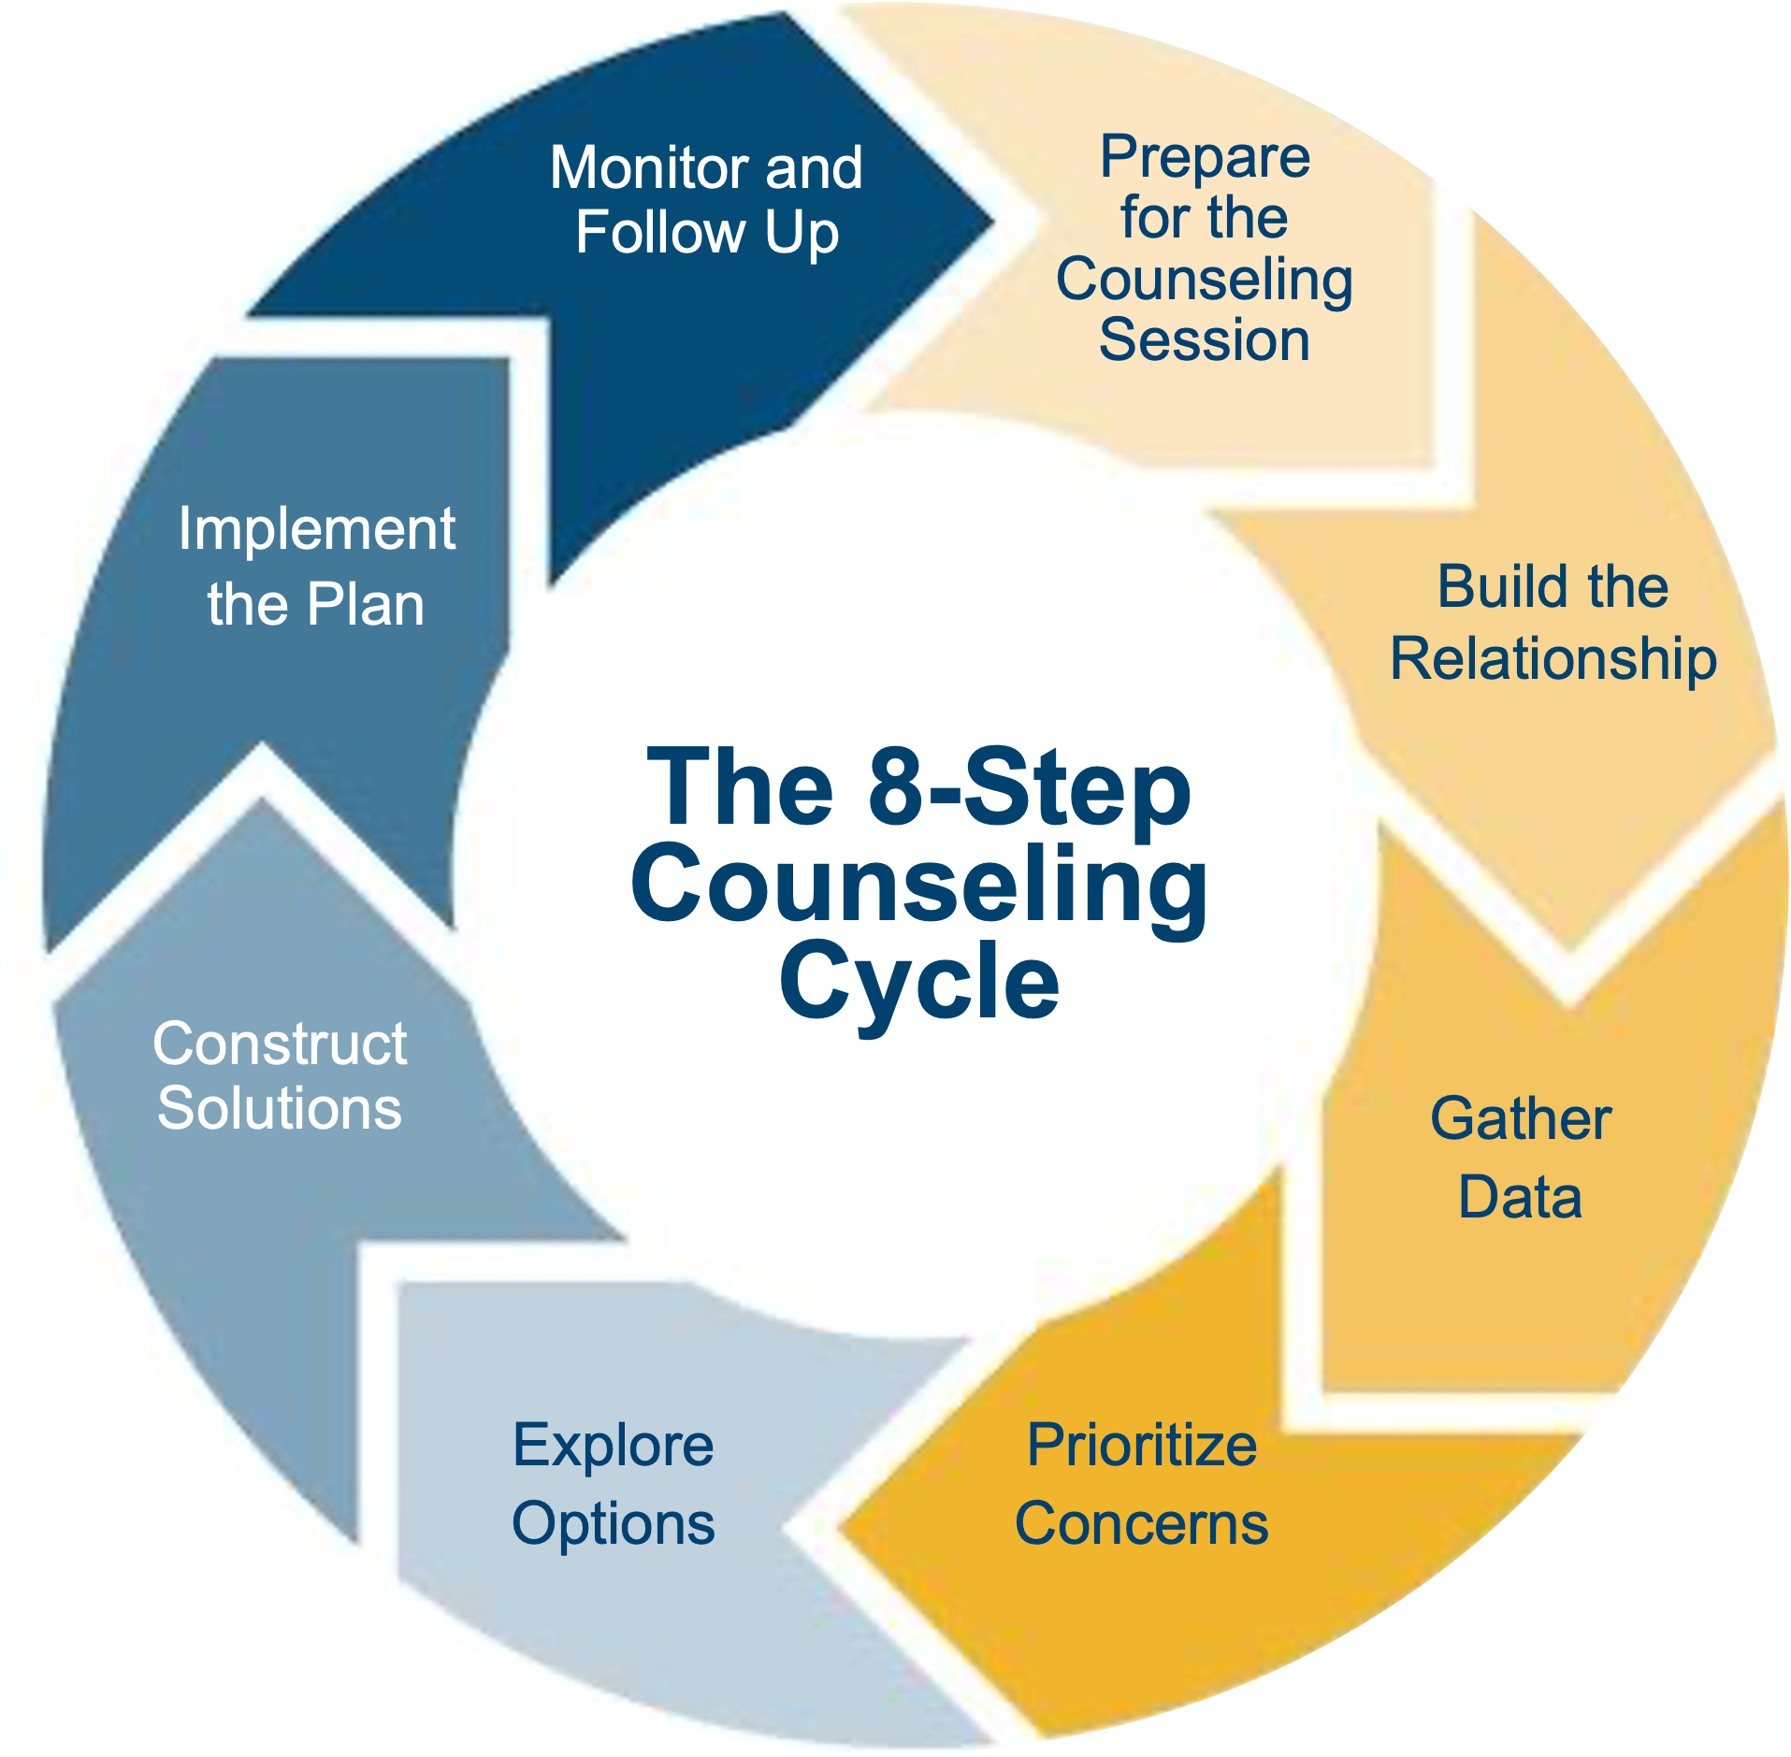
Agenda
Solution-focused Financial Counseling
The 8-Step Counseling Cycle
Financial Counseling Tools

Slide 3
Structure of Solution-focused Financial Counseling
Short-term
Goal-oriented
Task-centered
Positive
Encouraging
Client-generated solutions
SM
5-3

Slide 4
Solution-focused Financial Counseling Procedures
Construct effective solutions
Interrupt and substitute behavior patterns
Have the client DO something, no matter how small
A small change can have a ripple effect
Find the difference that makes the difference

Slide 5
Applying SFFC: The Best Response
“I can’t seem to save any money, no matter what I do.”
“I have no idea how much I spend on things each paycheck.”
“I’ve never had a budget and don’t know how to get started.”
“Why do I need to save money? I want to live for today.”
“It’s not fair that everyone I know gets to have a nice car, eat out, and go have fun.”
SM
5-4

Slide 6

The 8-Step Counseling Cycle
Monitor and Follow Up
Prepare
for the
Counseling
Session
Implement
the Plan
Build the
Relationship
The 8-Step
Counseling
Cycle
Construct Solutions
Gather
Data
Explore
Options
Prioritize
Concerns
SM
5-5

Slide 7
Step 1: Prepare for the Counseling Session
STEP
1
Schedule Appointment
Obtain Data
Determine
Counseling Type
Remedial
Preventive
Productive
SM
5-6 to
5-8

Slide 8
Prepare for the Counseling Session (continued)
STEP
1
Explain the
Counseling
Program
Provide Forms
• Checklist
• FPW
Ask for Any Questions
Get Mentally Prepared
Collect
Materials
SM
5-6 to
5-8

Slide 9
Step 2: Build the Relationship
STEP
2
Greet Client
Explain Privacy
Limitations
Discuss Normal
Feelings
Provide Complete
Attention
Explain Purpose
of Session
SM
5-9

Slide 10
LEAPS Method
STEP
2
L
Listen
E
Empathize
A
Ask Questions
P
Paraphrase
S
Summarize

Slide 11
SOFTEN Approach
STEP
2
S
SQUARELY Face Client
O
Maintain OPEN Posture
F
Lean FORWARD Toward Client
T
Give Client TOTAL Attention
E
Keep Good EYE Contact
N
NOD Affirmatively

Slide 12
Optional Activity –
Effective Listening Skills
STEP
2
The “I” Exercise
Discuss a topic without using “I,” “me” or “my”
Does financial counseling work?
Attitude about participating in financial counseling
Do couples communicate adequately about money?
How to deal with people who get emotional in counseling

Slide 13
Step 3: Gather Data
STEP
3
Ask the following SFFC questions:
What is your goal in coming here?
What are you doing that is working now?
How do you make that happen?
SM
5-5

Slide 14
Determine the Following
STEP
3
Client’s presenting concern
Client’s assessment of concern
Facts and situation influencing the problem
Steps client has already taken
Client’s immediate needs
Situations requiring change or crisis intervention
What client wants to do
SMART Goals

Slide 15


Construct the FPW
STEP
3
Complete Net Worth Statement
Complete Spending Plan
Review Cash Flow and Financial Summary
Review for Accuracy
Income
Savings and Investments
Living Expenses
Indebtedness
Surplus
Deficit

Slide 16
Potential Roadblocks
STEP
3
Consider professional mental health or clinical counseling referral:
Poor communication between spouses
Retaliation and punishment spending
Spending on addictions
SM
5-5

Slide 17
Benefits of Data Gathering
STEP
3
Information is familiar to the client
Client and CFS have living expenses in common
Moving closer to solutions
Perceived as helpful and interested
Completing FPW lays the groundwork for moving forward

Slide 18



Step 4: Prioritize Concerns
STEP
4
Immediate
Critical
Concerns
Pressing Financial Concerns
Long-Term Financial Concerns
SM
5-10

Slide 19
Make Appropriate Referrals
STEP
4
Community support
Installation military and family support center
Personal Financial Manager or Personal Financial Counselor
Additional resources will be covered later in the class

Slide 20
Step 5: Explore Options
STEP
5
Discuss the client’s thoughts about options
Discuss family members’ reaction
Determine benefits and risks of each option
Determine the cost of inaction
Consider potential legal implications
SM
5-5

Slide 21
Step 6: Construct Solutions
STEP
6
Chunk problem down into smaller parts
Assist client in finding solutions to implement immediately
The client must make the choice, not the CFS
Stress that solutions require change
Include spouse in finding solutions
SM
5-5

Slide 22
Construct Solutions (continued)
STEP
6
Complete the Action Plan
Use the FPW remarks and recommendation blocks
Complete the Projected column of FPW
Compute the new bottom line
SM
5-5

Slide 23
Step 7: Implement the Plan
STEP
7
Help client evaluate 1st and 15th spending
Choose options to start immediately
Explain how to track expenditures
Emphasize family involvement
Summarize session
Schedule follow-up session, if needed
SM
5-11

Slide 24
Step 8: Monitor and Follow Up
STEP
8
Find out what is working
Begin counseling cycle again
Use new information to address next concern
Designate future counseling, if needed
Summarize session
Follow up with referrals, if needed
SM
5-5

Slide 25
Client in Financial Recovery
8. Monitor and Follow Up
1. Prepare
for the Counseling Session
7. Implement the Plan
2. Build the Relationship
The 8-Step Counseling Cycle
6. Construct Solutions
3. Gather
Data
5. Explore
Options
4. Prioritize
Concerns
SM
5-5

Slide 26
Financial Counseling Tools
Sample Financial Counseling Checklist
Sample Appointment Email
Financial Counseling Book
Sample Privacy Act Statement
Guide to Writing a Case Narrative (if required)
How Do You Rate as a Money Manager?
Financial Values Clarification
SM
5-6 to
5-13

